Slide 1

Doubly Linked List

Slide 2
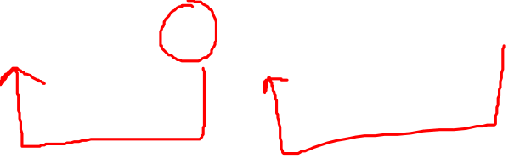
Start
Left
Info
Right
Left
Info
Right
Left
Info
NULL

Slide 3

Struct node{
int info;
struct node *left;
struct node * right;
}

Slide 4

Insertion in doubly linked list
temp
Left
Info
NULL
Start
Left
Info
Right
Left
Info
Right
Left
Info
NULL

Slide 5
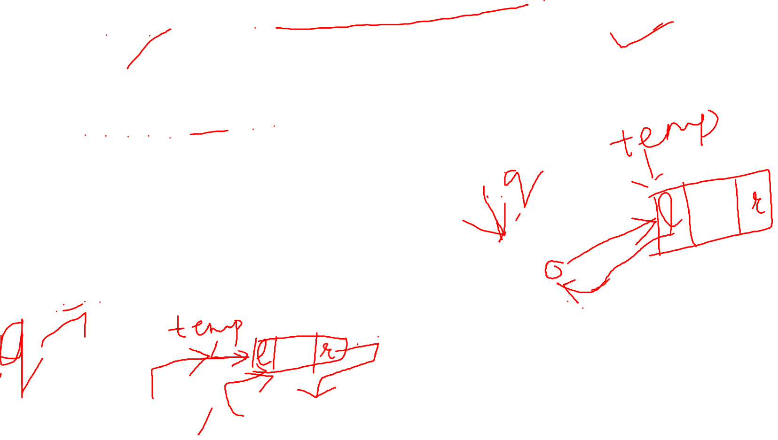
temp
Left
Info
NULL
IN THE END
IN THE BEGINNING
q=start
While(q->right!=NULL)
q=q->right
q->right=temp
Temp->left=q
Temp->right=start
Start->left=temp;
Start=temp
Start
Left
Info
Right
Left
Info
Right
Left
Info
NULL
Start
Left
Info
Right
Left
Info
Right
Left
Info
NULL

Slide 6
Deletion
From beginning
From end
From middle

Slide 7
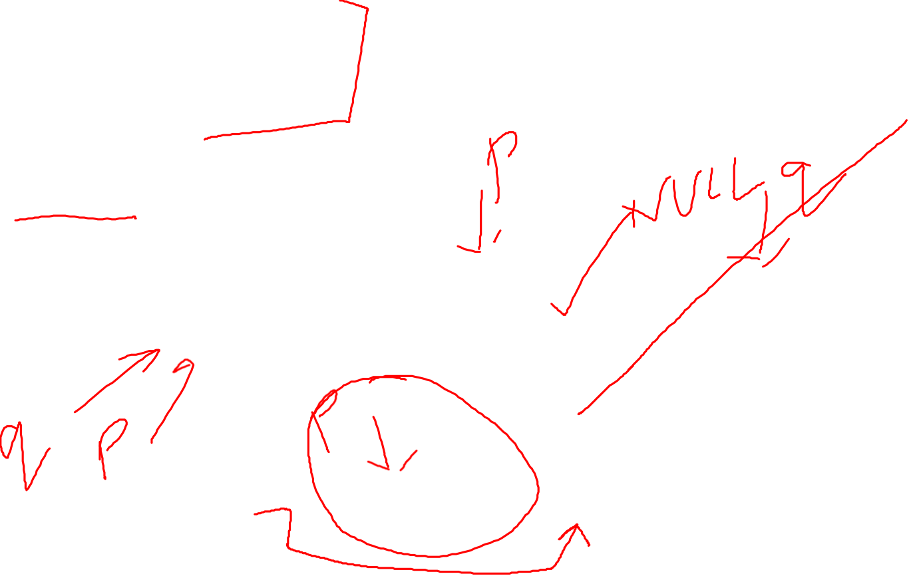
IN THE END
q=start
p=start
While(q->right!=NULL){
p=q
q=q->right
}
Free(q)
IN THE BEGINNING
p=start
Start=start->right
Free(p)
Start
Left
Info
Right
Left
Info
Right
Left
Info
NULL
Start
Left
Info
Right
Left
Info
Right
Left
Info
NULL

